Slide 1
Finance Report
The Augustine Fellowship, S.L.A.A., F.W.S., Inc.
2014 Annual Business Conference/Meeting
Houston, Texas

Slide 2
General Information
Fellowship-Wide Services (F.W.S.)
  Publishes literature approved by Conference
  Fulfills orders for literature, chips and etc.
  Maintains Website, publishes F.W.S. Newsletter
  Answers calls/media inquiries on sex and love addiction
  Involved in arranging International Recovery Conventions
  Arranges the Annual Business Conference/Meeting
  Protects S.L.A.A. copyrights, trademarks and logos

Slide 3
General Information
Fellowship-Wide Services Finances – background
  Income to Fellowship:
    Donations (about 40%),
    Sales of literature, chips, etc. (about 60% not including employee expenses).
  Fiscal Year: October 1st – September 30th.
  Financial Reports:
    Balance Sheet – (Statement of Position) a “snapshot” of assets/liabilities on a given date (Accrual Basis).
    Profit and Loss – (Statement of Activities) a report of income and expenses for a given period (Accrual Basis).

Slide 4
General Information
This Treasurer’s Report:
  Based on latest financial information through the third quarter of fiscal year (October 1st – June 30th).
  Updated financials generally provided monthly in F.W.S. Newsletter.
  2012-13 financial records were audited by the accounting firm of Randy Walker & Co. and full results were printed in Winter Newsletter -- Copy available for review at ABM

Slide 5
Consolidated Financial Reports
At the 2013 ABM, the Conference ratified the formation of a Texas corporation and voted to move the state of F.W.S. incorporation from Massachusetts to Texas.
  Process of dissolution still ongoing; a petition for dissolution and final transfer of assets filed in Massachusetts.
  Financial information provided today is actually a consolidation of the finances of two corporations as MA corp. still holding assets while business is being conducted through TX corp.

Slide 6
Balance Sheet

Slide 7
Balance Sheet
Assets – June 30th, 2014

Slide 8
Balance Sheet
Liabilities and Equity – June 30th, 2014

Slide 9
Balance Sheet
Assets – Accounts
  Old Massachusetts General Operating Account
  New TX General Operating Account
  PRF Accounts.
    Funds held in two Vanguard Short Term Federal Admiral Funds (VSGDX):
      Texas Fund: $25,000.00 (2014 anonymous donation)
      Massachusetts Fund: $160,212.58

Slide 10
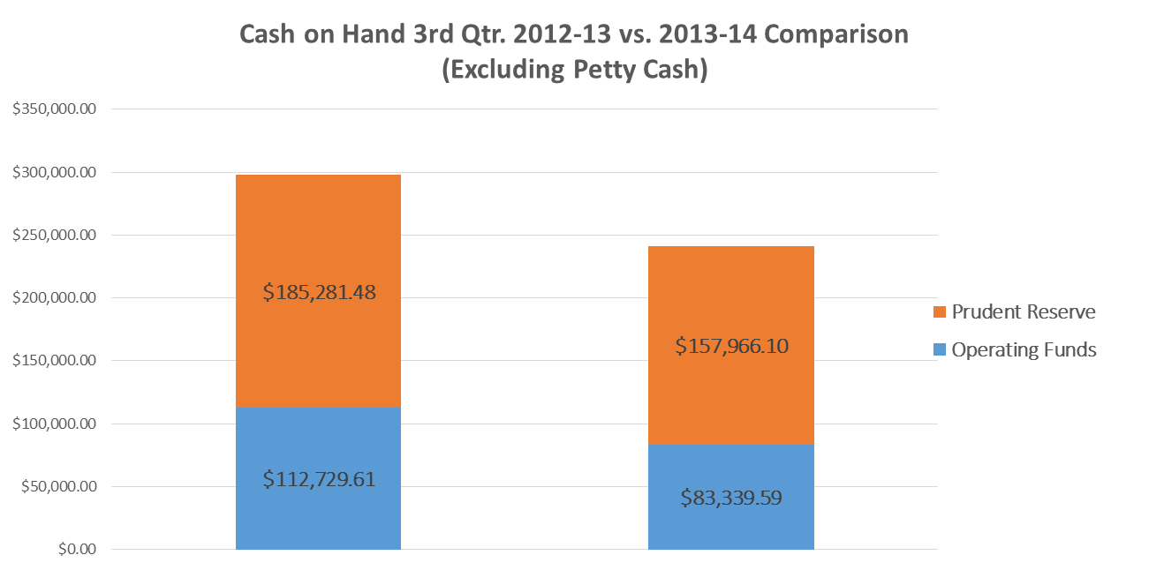
Balance Sheet
30-Jun-14
30-Jun-13

Slide 11
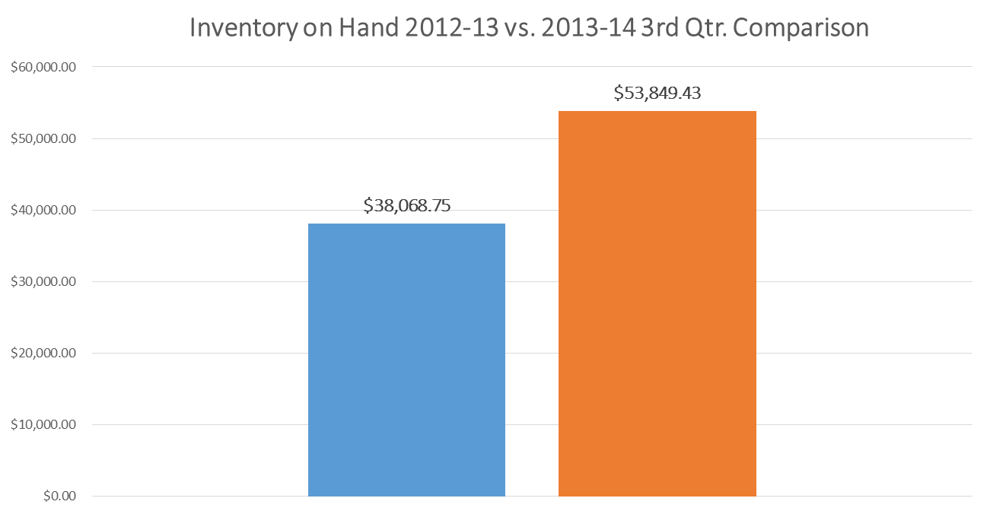
Balance Sheet
30-Jun-14
30-Jun-13

Slide 12
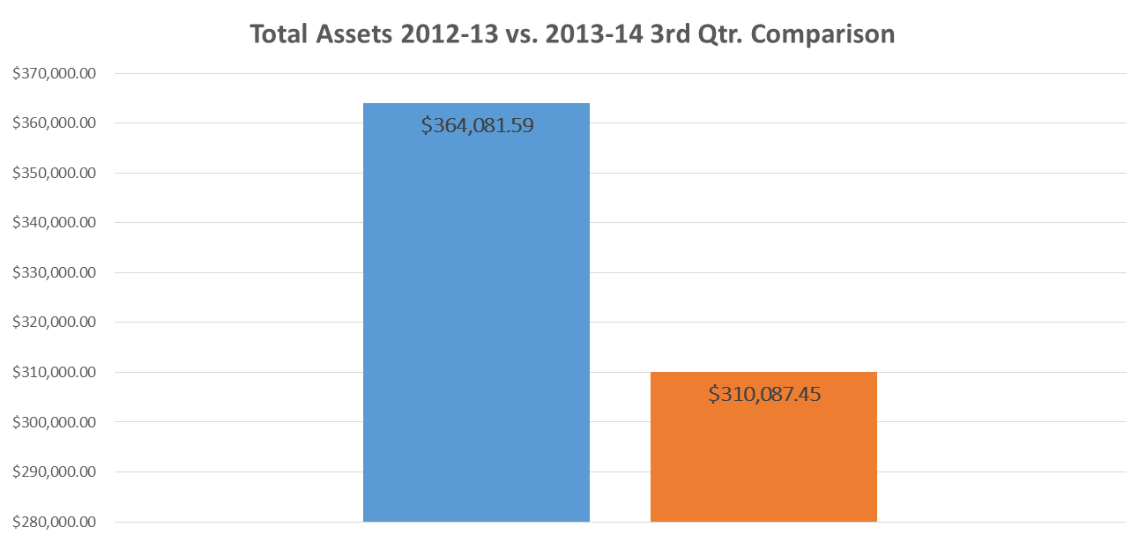
Balance Sheet
30-Jun-14
30-Jun-13

Slide 13
Profit and Loss Reports

Slide 14
Profit and Loss Reports
1st Three Quarters (Sept. 1st - June 30th) ABM, Donations, Investments
Note: 2014 Individual donations include $25,000 donation to PRF. Total donations through 3Q 2014 are $83,895.98 without it.

Slide 15
Profit and Loss Reports
1st Three Quarters (Sept. 1st - June 30th) Sales Income/Expense

Slide 16
Profit and Loss Reports
1st Three Quarters (Sept. 1st - June 30th) Conference/BOT/ABM Expenses

Slide 17
Profit and Loss Reports
1st Three Quarters (Sept. 1st - June 30th) Contract Services
Beginning January 1st, 2014, all full time F.W.S. Workers were converted from agency to F.W.S. Employees.

Slide 18
Profit and Loss Reports
1st Three Quarters (Sept. 1st - June 30th) Facilities and Equipment

Slide 19
Profit and Loss Reports
1st Three Quarters (Sept. 1st - June 30th) General Office Expenses

Slide 20
Profit and Loss Reports
1st Three Quarters (Sept. 1st - June 30th) Operations/Other

Slide 21
Profit and Loss Reports
1st Three Quarters (Sept. 1st - June 30th) Payroll
Beginning January 1st, 2014, all full time F.W.S. Workers were converted from agency to F.W.S. Employees.

Slide 22
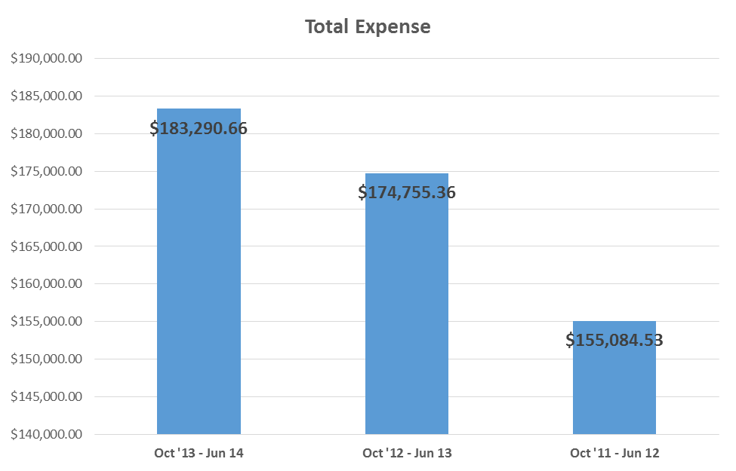
Profit and Loss Reports
1st Three Quarters (Sept. 1st - June 30th) Total Expenses

Slide 23
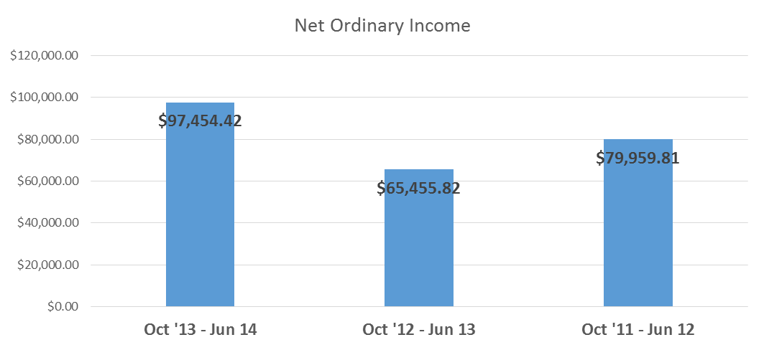
Balance Sheet
1st Three Quarters (Oct. 1st - June 30th) Net Ordinary Income
These figures are before payment of ABM expenses. In 2013, ABM expenses ran approximately $52,677.13

Slide 24
2014-15 Budget
Will be prepared in August/September based upon 2013-14 expenses
Copy of 2013-14 Budget in Binder with BFOC Report
Budget intended to include strategic planning through allocation of resources
Conference assigned a single amount and Conference Finance Committee allocates budget among various committees after receiving their proposed individual budgets

Slide 25
Questions?
Board of Trustees Contact: http://www.slaafws.org/contact/serviceinfo
Treasurer’s Contact: http://www.slaafws.org/contact/SB.
In your Binders:
  2013-14 Budget
  2013-14 Fiscal Year End Profit and Loss Report

